Slide 1
Constraints faced by Evaluators
Dr. Shankar Chatterjee
NIRD &PR, Hyderabad-500 030, Telangana, India
E-mails: shankarjagu@gmail.com & shankar_nird@yahoo.com

Slide 2
Quantitative & Qualitative Data
Quantitative: When quantity such as Number, Rate, Proportion etc. are required such as Population census.
Qualitative: When Perceptions, Attitudes, Beliefs etc. require for development of project etc.
(Sampling may be used- Simple random and stratified random)
Source: The Collection, Analysis & Use of M& E data - World Bank (1988)

Slide 3
Difference Between Questionnaire & Schedule
Questionnaire: Indirect way of Data Collection such as sending by post, talking over phone, email etc.
Schedule: Direct way of Data collection i.e. face to face talking such as Interview method etc.

Slide 4
Major constraints
Constraints can be separated into Following categories:
Time is a constraint. It shapes the scope of the evaluation question and the range of activities that can be undertaken to answer it. Time is finite the evaluator has to plan the study in "real time" with its inevitable constraints on what question can be posed, what data can be collected, and what analysis can be undertaken.
A rule of thumb is that the time for a study and the scope of the question being addressed ought to be directly related
Cost is a constraint. The financial resources available for conducting a study determine the limits of the study.

Slide 5
Staff expertise is a constraint. The design for an evaluation should not to be more intricate or complex.
Location and facilities are secondary constraints in comparison to the others, but they do impinge on the design process and influence the options. Location has to be considered from several aspects.

Slide 6
It should be sharply focused.
Survey Management Skills.
Untrained Staffs should not be assigned task.
Number Respondents should be proper.

Slide 7
SAMPLING ERROR & Non- SAMPLING ERROR
SAMPLING ERROR:
Using sample data presents the risk that results found in an analysis do not represent the results that would be obtained from using data involving the entire population from which the sample was derived.
Methods of reducing sampling error include increasing the sample size and ensuring that the sample adequately represents the entire population.
the larger the sample size, the smaller the standard error because the statistic will approach the actual value.
Non- SAMPLING ERROR:
Non- SAMPLING ERROR can include, but are not limited to, data entry errors, biased questions in a questionnaire, biased processing/decision making, inappropriate analysis conclusions and false information provided by respondents.

Slide 8
Concern
In designing the layout of the Questionnaire/Schedule, leave enough space for responses to open-ended questions but at the same time keep such questions to a minimum if possible.
Difficulty in getting a useful response rate (not everybody returns the questionnaire).
Open ended questions are more difficult to categorize.

Slide 9
“Dos and don´ts” in relation to use of evaluation questions Source: CAPTURING THE SUCCESS OF YOUR RDP: FOR THE EX POST VALUATION OF 2007-2013 RDPS GUIDELINES , European Evaluation Network for RD, June 2014, European Commission
Dos Provide answers transparently so that the judgment can be traced back to the chosen method and evidence on which the answers are based. | DON’Ts Provide answers to the EQs without reference to the evidence base and the methods by which the analysis has been conducted.
Develop programme-specific evaluation questions if common set does not address all evaluation needs. | Rely only on common evaluation questions.
Specify the success of the intervention for each of common and programme-specific evaluation questions using the judgment criteria. | Be silent about judgment criteria.
Check the consistency of each of the evaluation questions with judgment criteria and indicators. | Forget about linking programme-specific evaluation questions to indicators.
If inconsistencies and gaps are identified, reconstruct the missing or misleading parts to re-establish consistency. | Overlook consistency gaps between policy objectives, EQs, judgment criteria and indicators.
Apply the proportionality principle and invest relatively more in-depth analysis concerning the EQs which address areas of strategic priority and larger budgetary endowment. | Explore all evaluation questions in the same level of detail, regardless of the importance they have within the whole RDP.

Slide 10
Quality Research
It is set of Research Techniques.
It is used in Social science.
Data are collected from Relatively Small Group.
Generally NOT analyzed statistically.
Normally in Quantitative Research Large No. of Data are collected.

Slide 11
Quality Research
Most Qualitative Methods are Direct Approach.
Generally Questions are Direct & to the point.
Some cases: Believe/Belief, Values, Opinion, Food-habits etc.
Like Quantitative Research, Quality Research NOT very Structured.
Check-list, Semi-structured schedules etc are used in Quality Research

Slide 12
Quality Research
PRA as Methodology may be used.
As tools Transect Walk, Social Mapping, Resource Mapping, Seasonality Analysis, Venn Diagram, Time Line, Trend, Matrix Preference, Matrix Ranking etc are used.

Slide 13
PRA
PRA = PRA is a methodology which helps in interacting with local communities, understanding them & learning from them.
IMPORTANCE OF PRA:
PRA helps in generating different kind of data, identifying & mobilizing intended groups for decision making, project design, implementation, monitoring & evaluation

Slide 14
Basics of PRA
Rapport building
Role reversal
Unlearn
Listen & Learn
Trust / faith
Avoid Biases
Inter Disciplinary
Times Saving / rapid / but progressive Learning
Cross checking by people
Diversity and reality
Critical self awareness hand over the stick
Participation

Slide 15
PRA
It gives good understanding of a community & its capacities
Empowers the community
Facilitates Planning, Implementation, M&E.
Develops responsibility among the community.
Learning

Slide 16
IMPORTANT TOOLS OF PRA
Transect Walk: Systematically walking with informants through an area, observing, asking, listening, discussing, seeking problems, solutions & mapping & diagramming resources & findings.
Social Mapping:
Resource Mapping:
Seasonality Analysis:
Daily Time use Analysis: Indicating relative amount of time, degrees of drudgery (etc) of Activities.

Slide 17
Time Line: Chronologies of events, major events with DATES.
Trend Analysis: Past, present e.g. cropping etc.
Venn Diagram:
Matrix ranking or scoring:
Immediate Report writing after PRA.

Slide 18
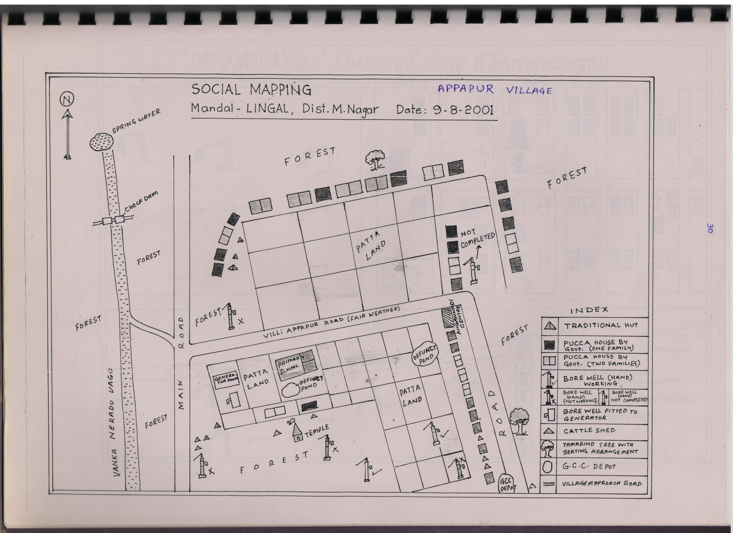

Slide 19
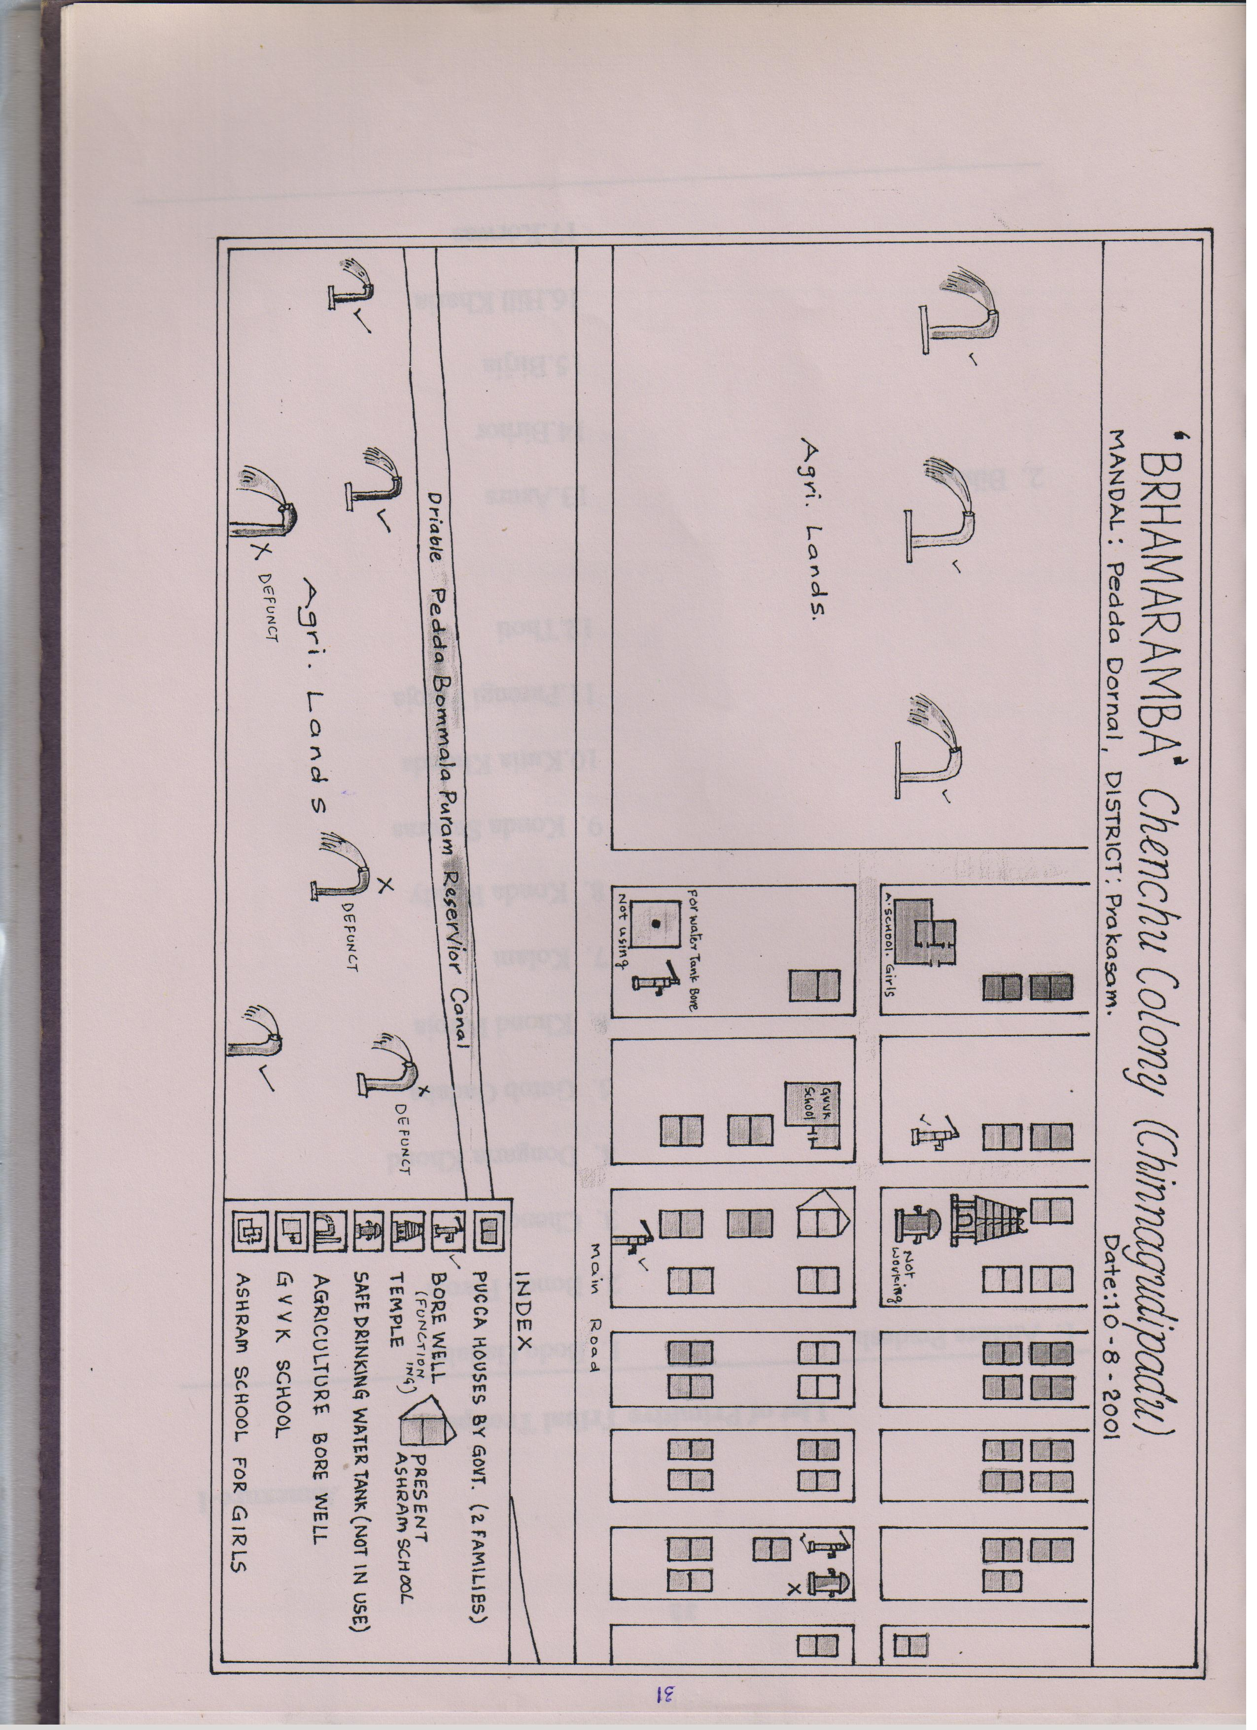

Slide 20
PREFERENCE RANING FOR TREATING DISEASES AT MALLIKARJUNA CHENCHUS COLONY/Prakasham District
Disease/Service | Snake Bite | Jaundice | Malaria | Diar | Skin Dis | Boil | Stomach Pain or Head Ache
Local Ojha | 1 | - | - | - | - | - | -
Herbal Practitioner | - | 1 | 1 | 1 | 1 | 1 | 1
Com. Health Worker | - | 2 | - | 2 | 2 | - | 2
ANM | - | - | - | - | 3 | - | -
PHC | 2 | 3 | 2 | 3 | 4 | 2 | 3
Preference – Highest=1, Lowest=4

Slide 21
Time Line Showing Crops Grown Before & After Irrigation Project at Tambewadi Village, Pathardi Block, Ahmednagar district, Maharashtra
Here I have developed some indicators as mentioned below:
9 SHGs were formed with 49 members having land under SGSY of (GoI)- Indicators social and economic Particulars
Each SHG was given Loan & Subsidy- Amount of Loan & Amount of Subsidy/INPUT
Their Knowledge about Repayment of Loan and Activities. And also how they Utilized the money? (crop production etc) /OUTPUT.
Marketing of their Goods/EFFECT
Major Outcome, Quality of Life etc/ IMPACT

Slide 22
Time Line Showing Crops Grown Before & After Irrigation Project at Tambewadi Village, Pathardi Block, Ahmednagar district, Maharashtra ( study in 2002 & 2010 & Project Started in 2000)
Irrigation available 55.88 Ha. (100%)
Before Project After Project
Kharif : Kharif :
Bajra , Groundnut Groundnut, Dal, Bajra
Vegetables etc.
Rabi crops – Jowar, Onion Rabi crops :Wheat, Vegetables, Onion Other Crops: NIL Other Crops:
Cash crops: Sugarcane
Horticulture: Banana,
Pomegranate

Slide 24
Village: Machina, Taluk – Belthangady PBG: Marakkada B; No. of members : 5 ; Age of the SHG:12 Years Savings of the members : Rs. 35,380.00 No. of labour sharing day : 3219 Value of labour shared: Rs. 2,41,425.00
Sl. No. | Name of the member | Land owned (Acres) | Crops grown | Loan availed (Rs.) | Purpose of the loan
1. | Dombayya sherigar | 5 | Areca nut, coconut, cashew, vegetables | 99,000.00 | Solar lamp purchase, house repair, areca nut, repayment of loans, Education (Tailoring)
2. | Monappa Gowda | 2.5 | Areca nut, coconut, Vegetables | 26,000.00 | Piggery, house repair, loans repayment
3. | Sundara Poojari | 2 | Areca nut, coconut, vegetables | 30,000.00 | Pump purchase, Jeep purchase
4. | Pramod Gowda | 0.5 | Areca nut, coconut | 50,000.00 | Pump purchase, construction of cow shed, gold purchase
5. | Dharrnappa Gowda | 2.5 | Areca nut, coconut, Cashew, vegetables | 20,000.00 | Construction of cow shed, compost purchase

Slide 25
Village: Mundur Village, Taluk:Belthangady Name of the Pragathibandhu SHG : Kalyaradda No. of members involved : 5 Age of the SHG : 16 Years Savings of the members : Rs. 47,460.00 Total Labour Sharing days : 4080
Sl. No. | Name of the member | Land owned (Acres) | Crops grown | Loan availed (Rs.) | Purpose of the loan
1. | Chindananda Poojari | 1.5 | Areca nut, Coconut, Paddy | 73,590.00 | House construction, marriage, Agri development
2. | Sundara Poojari | 1.5 | Areca nut, Coconut, Paddy | 76,585.00 | Daughters marriage, Pump Purchase, Agri development, well repair, Cattle Shed repair
3. | Alex Vegus | 1.50 | Areca nut, Coconut, Rubber, Jasmine | 1,13,745.00 | Vehicle purchase, Jasmine cultivation , life insurance, well repair
4. | Somappa Poojari | 1 | Areca nut, Coconut | 35,480.00 | House repair, Medical, Cattle Shed rapair, Life Insurance
5. | Rajendra Poojari | 1.50 | Areca nut, Coconut, paddy | 1,24,855.00 | House repair, Well repair, marriage, life insurance

Slide 26
Village: Odilnala village, Belthangady Taluka Name of the Pragathibandhu SHG : Mairalike-A No. of members involved : 6 Age of the SHG : 16 Years Savings of the members : Rs. 49,650.00 Total Labour Sharing days : 5630
Sl. No. | Name of the member | Land owned (Acres) | Crops grown | Loan availed (Rs.) | Purpose of the loan
1. | Jayanand Nayak | 6 | Areca nut, Coconut, Rubber, Banana, Pepper | 2,87,805.00 | Agri development, Rubber, Dairy, Solar light installation, Gobar Gas
2. | Shyamanna Naik | 4 | Areca nut, Coconut, Banana, vegetables | 1,98,280.00 | Agridevelopment, Rubber, Diary, Solar light installation, Gobar Gas, Washing machine purchase
3. | Vamana Mulya | 4 | Areca nut, Coconut, Banana | 2,11,301.00 | Agri development, Dairy, Solar light installation, Gobar Gas
4. | Andru D’ souza | 3 | Areca nut, Coconut, Banana | 2,86,685.00 | Areca nut cultivation, Tank construction, Pump & Pipe purchase.
5. | Vanishree | 5 | Areca nut, Coconut, Banana, Pepper | 1,29,800.00 | House repair, electrification, Vehicle purchase

Slide 27
PBG in Karnataka

Slide 28
PBG in Karnataka

Slide 29
PBG in Karnataka

Slide 30
PBG in Karnataka

Slide 31
MCP: Case from Warangal District, AP Study conducted on 28 August 2013
Srinivasa SHG at Thirumalagiri Village , Athmakur Mandal
10 Women BC, formed in August 1999
No. of Meetings held 169
Average no. of Loan /member 09
Average Amount of Loan /member : Rs.85000
1st Bank loan taken in 2003- Rs. 10000 & repaid
2nd Bank loan taken in 2004- Rs. 15000 & repaid
3rd Bank loan taken in 2005- Rs. 40000 & repaid
4th Bank loan taken in 2007-Rs. 80000 & repaid

Slide 32
MCP: Case from Warangal District, AP Study conducted on 28 August 2013
5th Bank loan taken in 2009-Rs. 200000 & repaid
6th Bank loan taken in 2011-Rs. 300000 & repaid
Rs280000
VO Loan taken in 2013 Rs. 108000 & Repaid
Rs. 22000

Slide 33
MCP: Case from Warangal District, AP Study conducted on 28 August 2013: Few Cases
Sridevi (34 yrs): Rs. 50,000 cloth business & tailoring. Cloth house to house selling
Vijayalaxmi (30 yrs): Rs. 20,000 plastic chair selling
Jyothi (28 yrs): Rs. 40, 000 Selling of Cotton & also Health Asst. earning wage Rs 2500/Month
Sartitha (22 yrs): Rs. 10,000 Having Agri.Land-2 acres growing mainly cotton used for LOAN used for Cotton Cultivation

Slide 34
Mohammad Bee from Kalva village,Orvakal Mandal, Kurnool district, Andhra Pradesh
Mohammad Bee illiterate, a very poor woman up to 1994. Married at 13 years & mother at 18 years.
Husband was daily labourer
As assets, a hut, a small cot , 4 cooking items & 2 saris (Indian women wear)
Joined with her husband for working as laborer to get 2 square meals a day
Blessed with 3 male children. Admitted in school not for education but for 2 pairs of dresses which were provided at free of cost. Moment dresses were provided, children were withdrawn from the school and asked to earn.

Slide 35
Case of Mohammad Bee (Contd.)
Chand self-help group formed in the village in 1995. Bee joined. Identified poorest of the poor & got loan within 6 months. Loan amount was Rs. 1000 @2% rate of interest/month earned Rs 5000.
After repaying of loan, took another loan; process continued for 24 times ;borrowing & repaying.
Repaid Rs. 0.6 million amount of loan taken time to time and taken fresh loan of Rs. 0.4 million, repaying regularly. Now having a concrete house & 11 acres of agricultural land including 6.5 acres of mango garden.
Husband no longer working as a labourer.
Mohammad Bee attends self-help group meetings, watches television and no village functions are held without her. A case of “Zero to Hero”

Slide 36
Case 2: Ramakka
Ramakka a very poor woman of marginalize social group, before joining Menaka Gandhi self-help group in 1995.
Never gone school. Eating 2 square meals a day difficult.
Out of 5 children, 4 children died due to lack of care and poverty. Later her husband also died.
After joining the self-help group, she was sanctioned Rs. 5000 for undertaking business, started selling of eggs.
Daily earning was Rs. 25. Repaid loan & got another dose of loan for sheep rearing. Process continued for 14 times.
Now she owns 5 acres of agricultural land and 1.5 acres of mango garden, which are looked after by her married son. Another case of ‘Zero to Hero’

Slide 37
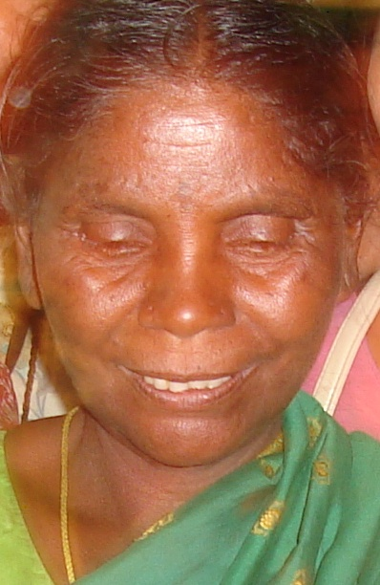
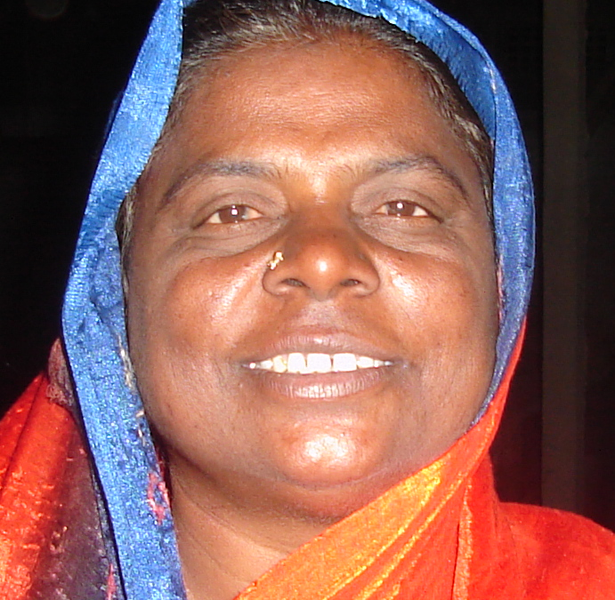
THANKS

